Slide 1
Efficiency, Quality,
User Experience,
& Training Needs in AI-assisted Vocabulary Test Bank Creation
Brigham Young University
Presenters: Joyce Tan, Shantona Mir, Akira Nagahama, Ginny Tien Le, WenXuan Wan, Vidya Irene Purushottam

Slide 2



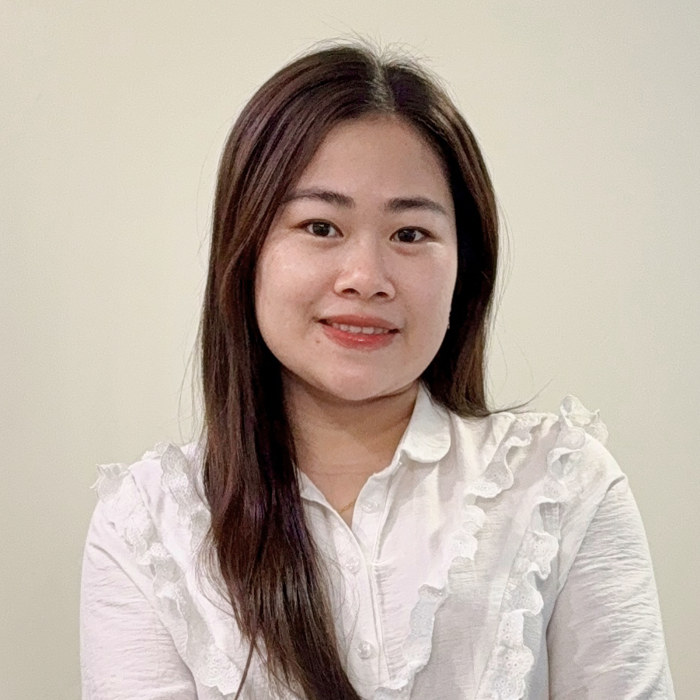
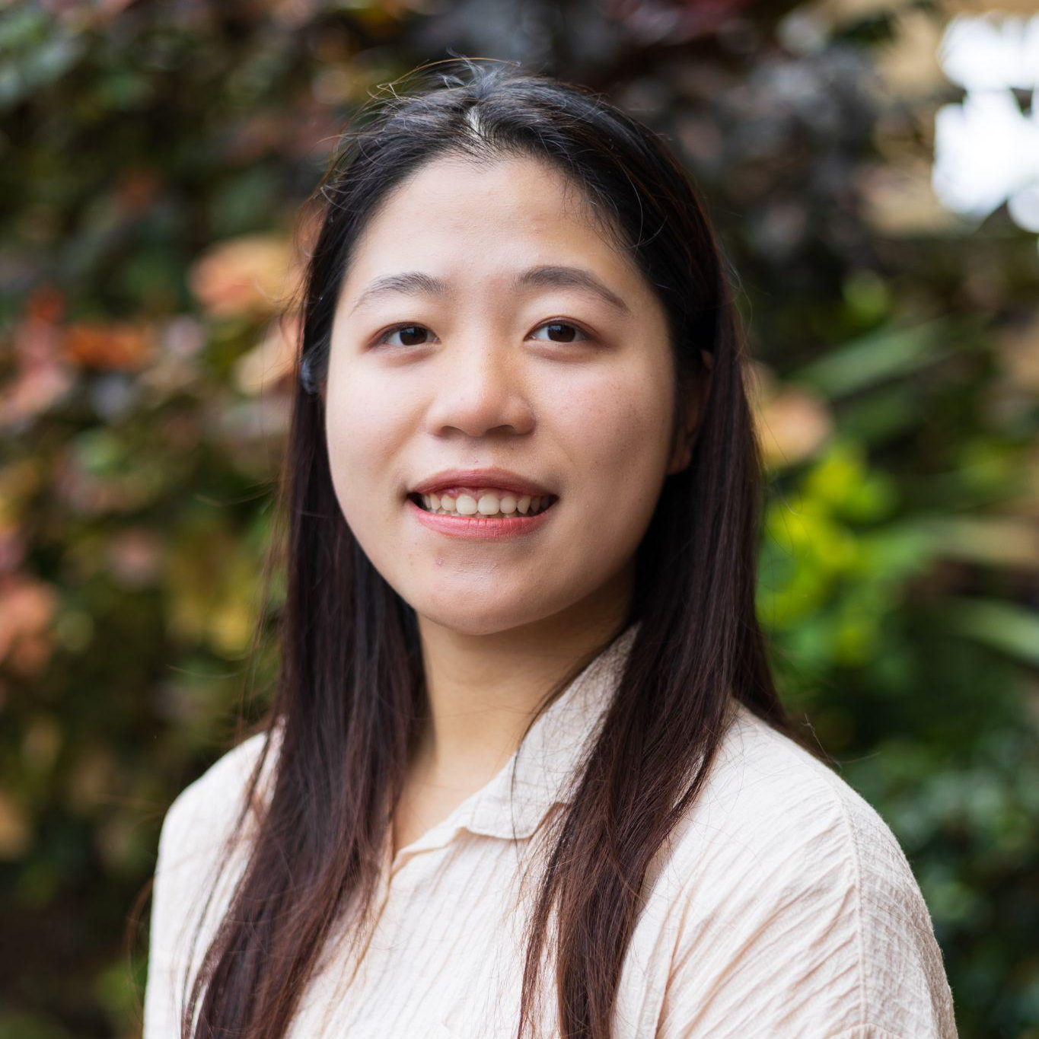
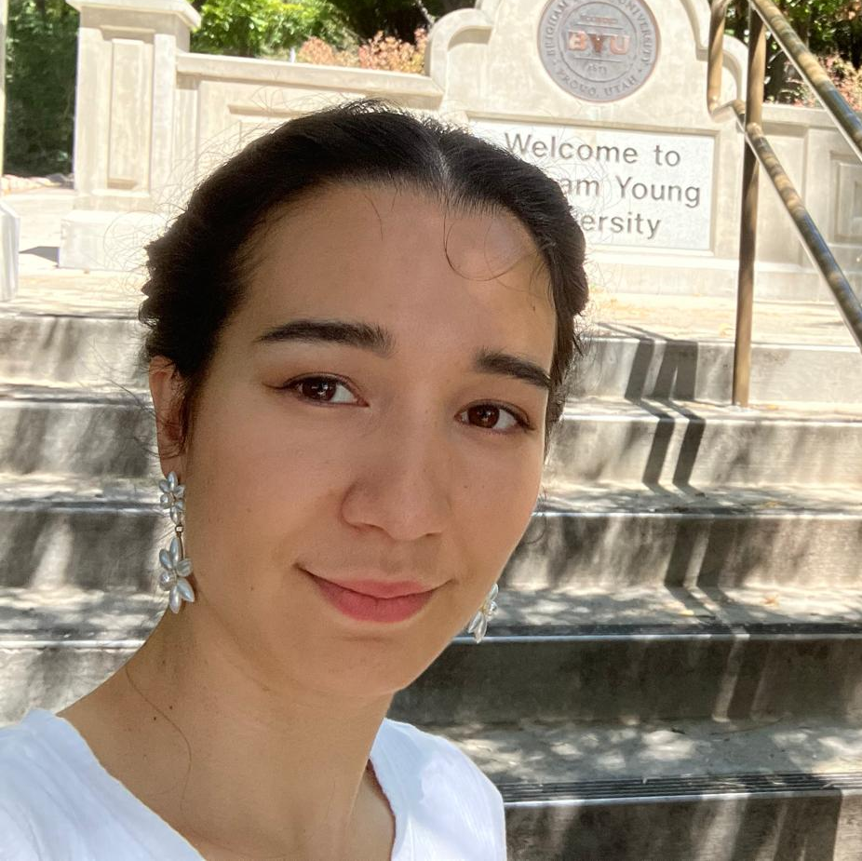
BYU
Meet the team
Joyce Tan
PhD EdTech
Irene
MA TESOL
Tien Le
(Ginny)
MA TESOL
Shantu
MA TESOL
WenXuan Wan
(Camy)
MA TESOL
Akira Nagahama
MA TESOL

Slide 3

BYU
Contents
2025/Q4/October
Insights from a Mixed-method Study with TESOL Graduate Interns
1.
Introduction & Background
2.
Method
3.
Findings & Discussions
4.
Activities (Resource)
5.
Wind up : Q & A, Takeaways, Share Corner

Slide 4
BYU
Purpose of the Study
Examine how generative AI impacts vocabulary test creation
Explore efficiency, quality, user experience, and training needs
Address challenges and opportunities for TESOL educators using AI
Irene

Slide 5
BYU
Research Question
RQ1: Time investment and revision rate across item types
RQ2: Common error types in AI-generated test items
RQ3: User experience and acceptance of AI tools
RQ4: Training and support needs for ethical, effective AI use
Irene

Slide 6
BYU
Design –
Mixed Methods
Convergent Parallel Design
Quantitative: Online surveys 26 Questions - 6 open-ended.
Qualitative: Interviews (14 questions)
Integration: Thematic synthesis of both data types
Irene

Slide 7
BYU
Participants & Context
5 TESOL graduate interns
Created around 3,000 vocabulary test items using AI tools
Mixed item types: MCQ, fill-in-the-blank, word forms
Varied AI experience (ChatGPT, DeepSeek, etc.)
Irene

Slide 8
BYU
Data Collection Tools
5-point Likert-scale surveys
Open-ended responses
Peer review rubrics
Interviews (~30 mins): efficiency, error types, UX, training
Ginny & Shantu

Slide 9
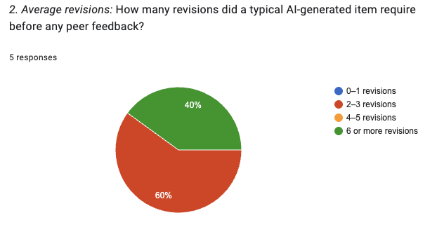
BYU
FINDINGS AND DISCUSSION (QUANT)
RQ1 – Efficiency across item categories
“For each intern, what are the average time investment and number of revisions required to produce AI-generated vocabulary test items within each major category… and how do these metrics compare across categories and interns?”
Time allocation:
  Mean = 771 s (≈ 12.8 min) per item
  High variability across interns and item categories.
Revisions:
  Mean = 4.2, Median = 4, Mode = 4, Std. Dev = 0.98 - low variability.
Ginny & Shantu

Slide 10
BYU
FINDINGS AND DISCUSSION (QUAL)
RQ1 – Efficiency across item categories
“For each intern, what are the average time investment and number of revisions required to produce AI-generated vocabulary test items within each major category… and how do these metrics compare across categories and interns?”
Iterative Prompt Refinement Boosts Efficiency
All interns began with trial-and-error prompt writing. Efficiency improved once they learned to give complete, precise prompts.
Task Type and Context Complexity Affect Time
MCQs within context were unanimously cited as the most time-consuming.
Workflow Adaptation Increases Productivity
Interns developed individualized workflows to manage cognitive load and tool limitations.
“It took four or five tries in the beginning, but once I understood how it’s done, it was pretty fast.”
Ginny & Shantu

Slide 11
BYU
RQ2 – Item quality and error types (QUANT)
“What are the most common error types encountered in AI-generated vocabulary items and how frequently do they occur?”
Repetition errors were the most common, appearing in approximately 60% of cases (M = 0.6, Median = 1.0, Mode = 1, SD = 0.55).
Ignored instruction errors (M = 0.2, SD = 0.45) and formatting issues (M = 0.2, SD = 0.45) were less frequent but still present.
The low standard deviations across all error types indicate that these patterns were fairly consistent across interns, meaning the repetition issue is likely systemic to the AI generation process rather than individual user error.
Ginny & Shantu

Slide 12
BYU
RQ2 – Item quality and error types (QUAL)
“What are the most common error types encountered in AI-generated vocabulary items and how frequently do they occur?”
Recurrent Formatting and Consistency Errors
Frequent AI mistakes included repetitive answer keys, inconsistent format, and length imbalance.
Surface-Level Understanding and Context Insensitivity
AI often ignored context, producing shallow or duplicated questions.
Human Revision and Editorial Oversight Remain Essential
Most interns estimated 50% of AI-generated items required revision.
“AI tend to repeat the same theme or context across multiple items.”
“You have to read everything to make your question better.”
Ginny & Shantu

Slide 13
BYU
RQ3 – User Experience and Acceptance (QUANT)
“How do interns perceive the usefulness, ease of use and satisfaction associated with AI-assisted item generation, and what factors influence these perceptions?”
Most interns rated the experience on 5-point Likert scale as 4 (agree) or 5 (strongly agree)
 | Mean | Median | Mode | SD | Satisfaction Level
Overall Quality Satisfaction | 3.8 | 4.0 | 4 | 0.84
Perceived Usefulness | 3.8 | 4.0 | 4 | 0.40
Ease of Use | 3.8 | 4.0 | 4 | 0.40
Future Use Satisfaction | 3.8 | 5.0 | 5 | 0.89
Ginny & Shantu

Slide 14
BYU
RQ3 – User Experience and Acceptance (QUAL)
“How do interns perceive the usefulness, ease of use and satisfaction associated with AI-assisted item generation, and what factors influence these perceptions?”
Perceived Usefulness and Efficiency
Participants valued AI for saving time, inspiring ideas, and reducing cognitive load.
Frustration with Inconsistency and Control
While helpful, AI required constant supervision and re-prompting.
Frustration with Inconsistency and Control
While helpful, AI required constant supervision and re-prompting.
“The most helpful feature was the speed of generating content and having a range of options.”
Ginny & Shantu

Slide 15
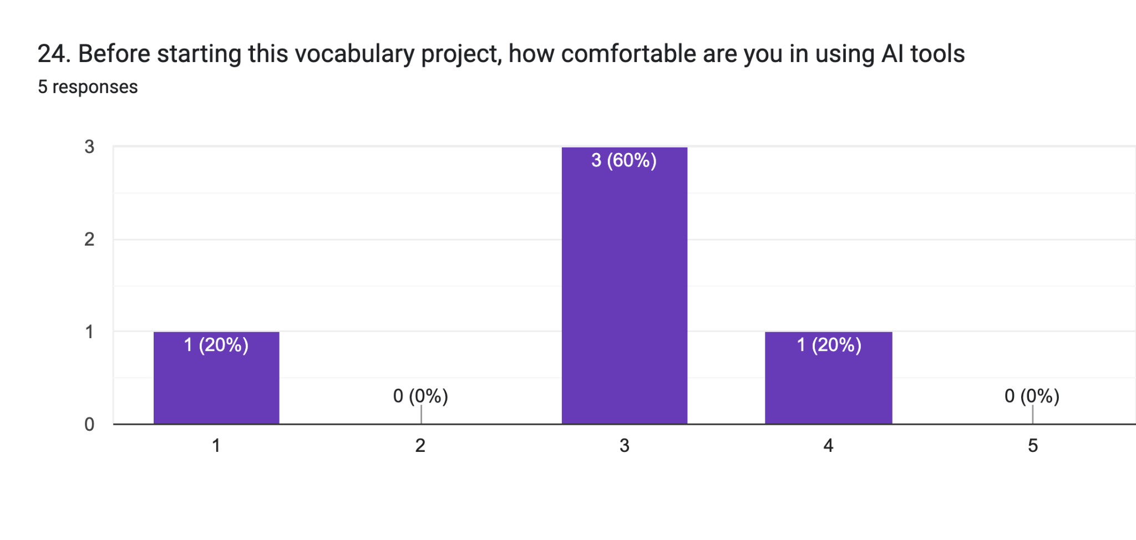
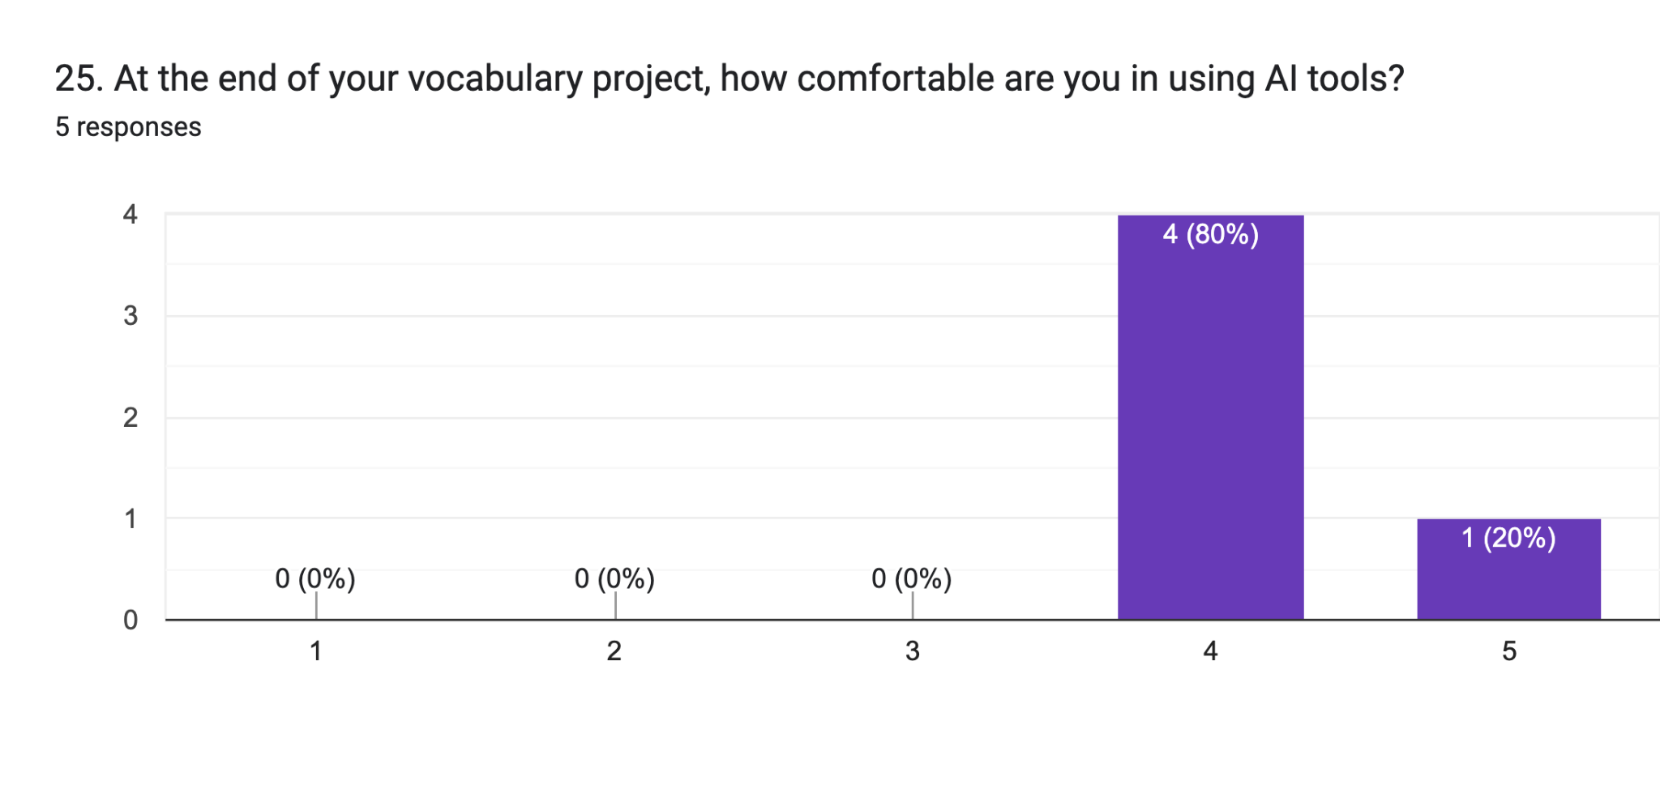
BYU
RQ4 – Training and Support Needs (QUANT)
“What challenges do interns encounter when using AI tools for vocabulary item creation, and what training or resources do they believe would improve their efficacy and ethical use of AI?”
All interns strongly agreed on the necessity of human oversight (M = 5.0, Median = 5.0, Mode = 5, SD = 0.00), showing unanimous perception of its importance.
Preparedness levels increased from M = 2.4 (SD = 1.09) before the project to M = 4.2 (SD = 0.45) afterward, indicating a clear growth in confidence and competence.
Ginny & Shantu

Slide 16
BYU
RQ4 – Training and Support Needs (QUAL)
“What challenges do interns encounter when using AI tools for vocabulary item creation, and what training or resources do they believe would improve their efficacy and ethical use of AI?”
Need for Prompt-Writing Training
All participants emphasized targeted prompt-engineering instruction as the top training need.
Desire for Collaborative Learning and Peer Sharing
Interns recognized the value of sharing strategies to improve efficiency and output quality.
Practical Tool Support and Access Limitations
Differences between paid and free versions influenced productivity.
“Collaboration, even in AI, is really important. AI doesn’t have a brain of its own.”
Ginny & Shantu

Slide 17
BYU
Overall Quant & Qual Findings
AI-assisted vocabulary item generation was efficient but uneven in time use (M = 12.8 mins, SD = 260.58) with consistent revision patterns (M = 4.2, SD = 0.98).
Repetition errors (60%) were the main quality issue, while other error types were rare and stable across interns.
User perception was highly positive (Usefulness/Ease/Satisfaction ≈ 4–5), with strong acceptance of AI as a support tool.
Human oversight remained essential (SD = 0.00), and preparedness increased notably (M = 2.4 —- 4.2), underscoring the value of targeted training.
Across participants, three cross-cutting themes emerge:
Prompt precision = productivity. Effective prompting was the single biggest determinant of efficiency and quality.
Human oversight remains irreplaceable. Despite automation, interns invested significant effort in editing, contextualizing, and quality-checking items.
Collaboration and structured training are key. Shared prompt libraries, peer review, and examples of good/bad outputs are critical for sustainable AI-assisted item creation.
Ginny & Shantu

Slide 18
BYU
Now……… What were the findings of RQ1 (QUANT + QUAL) ?
Ginny & Shantu

Slide 19
BYU
Writing a prompt
Akira & Camy
Persona: Who do you want the AI to be? “As a teacher/student…”
Task: Clearly state the end goal with action verb
Context: User’s background, vision of success, and environment
Format: How to present the answer.
Example: An example shows what the final work should look like.
Tone: The attitude or feeling you want to express.

Slide 20
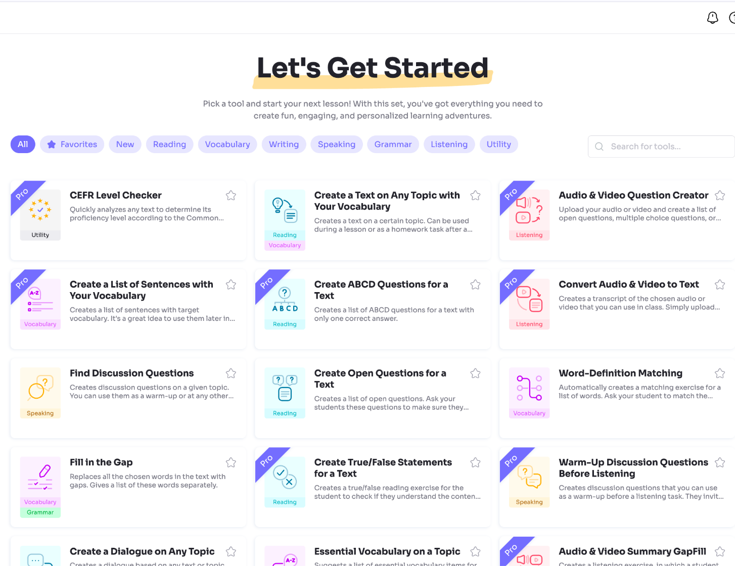
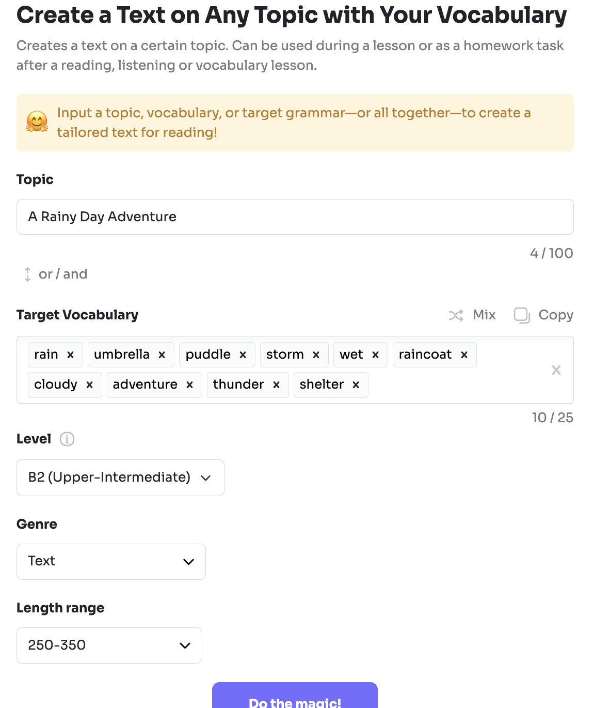
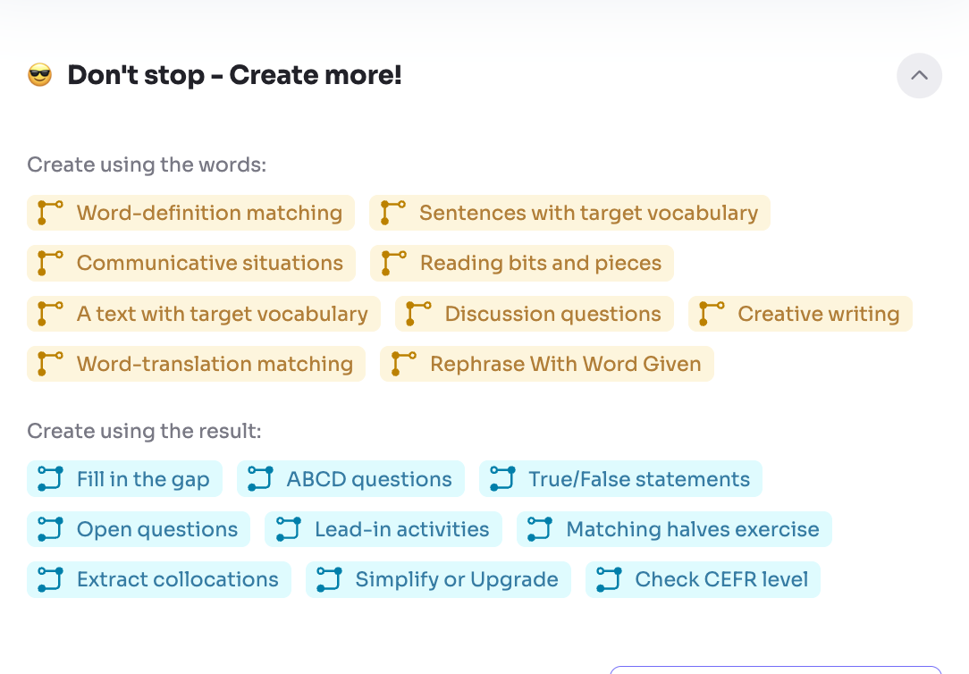
BYU
Twee
Akira & Camy
Material creation
Dialogue with target vocabulary (5 free trial)
Audio & written material with target vocabulary

Slide 21
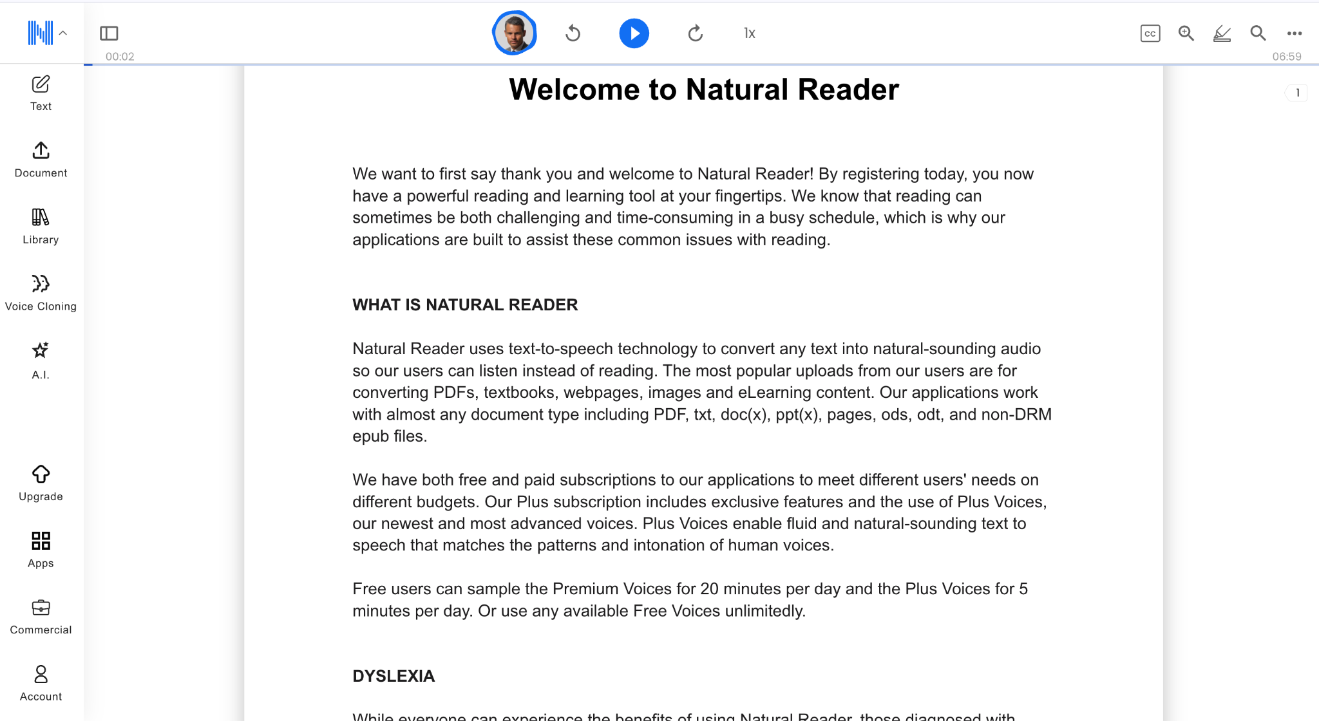
BYU
NaturalReader
Akira & Camy
Vocabulary Focus in speaking and listening
Check the pronunciation of vocabulary
Listening practice for new vocabulary

Slide 22
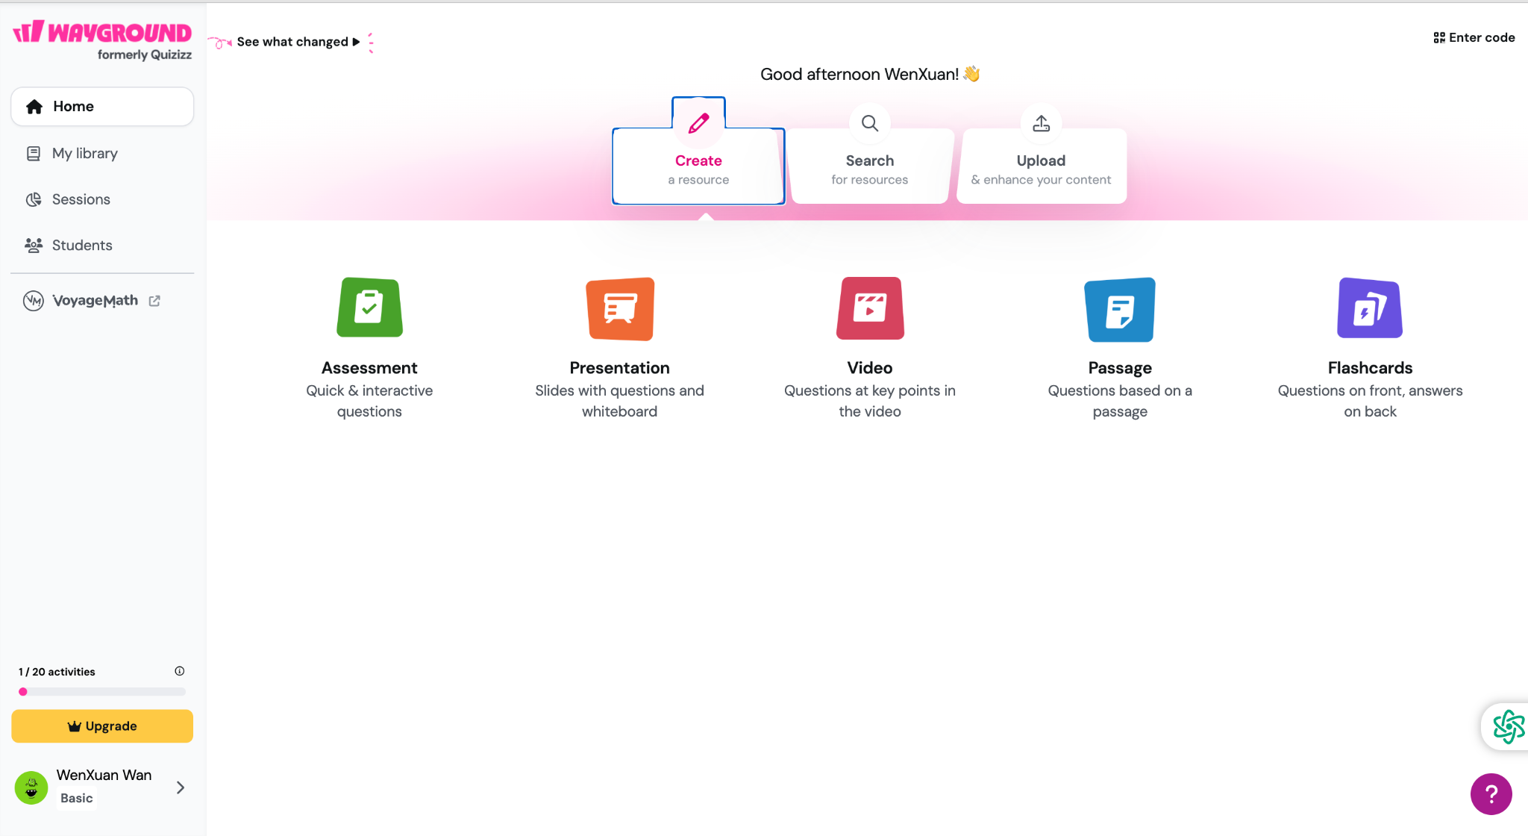
BYU
Wayground
Akira & Camy
Material Creation
Especially focused on vocabulary teaching
It offers many activities and teaching formats
There is a teacher track

Slide 23
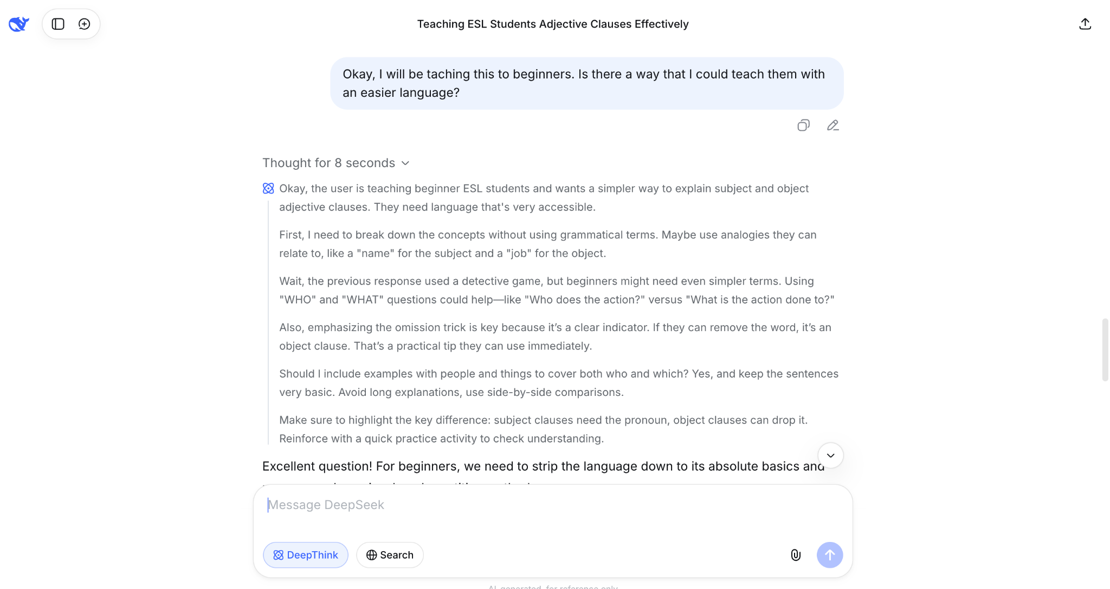
BYU
Deep Seek
Akira & Camy
Material Creation
Very similar to ChatGPT, but it is free
DeepThink feature

Slide 24
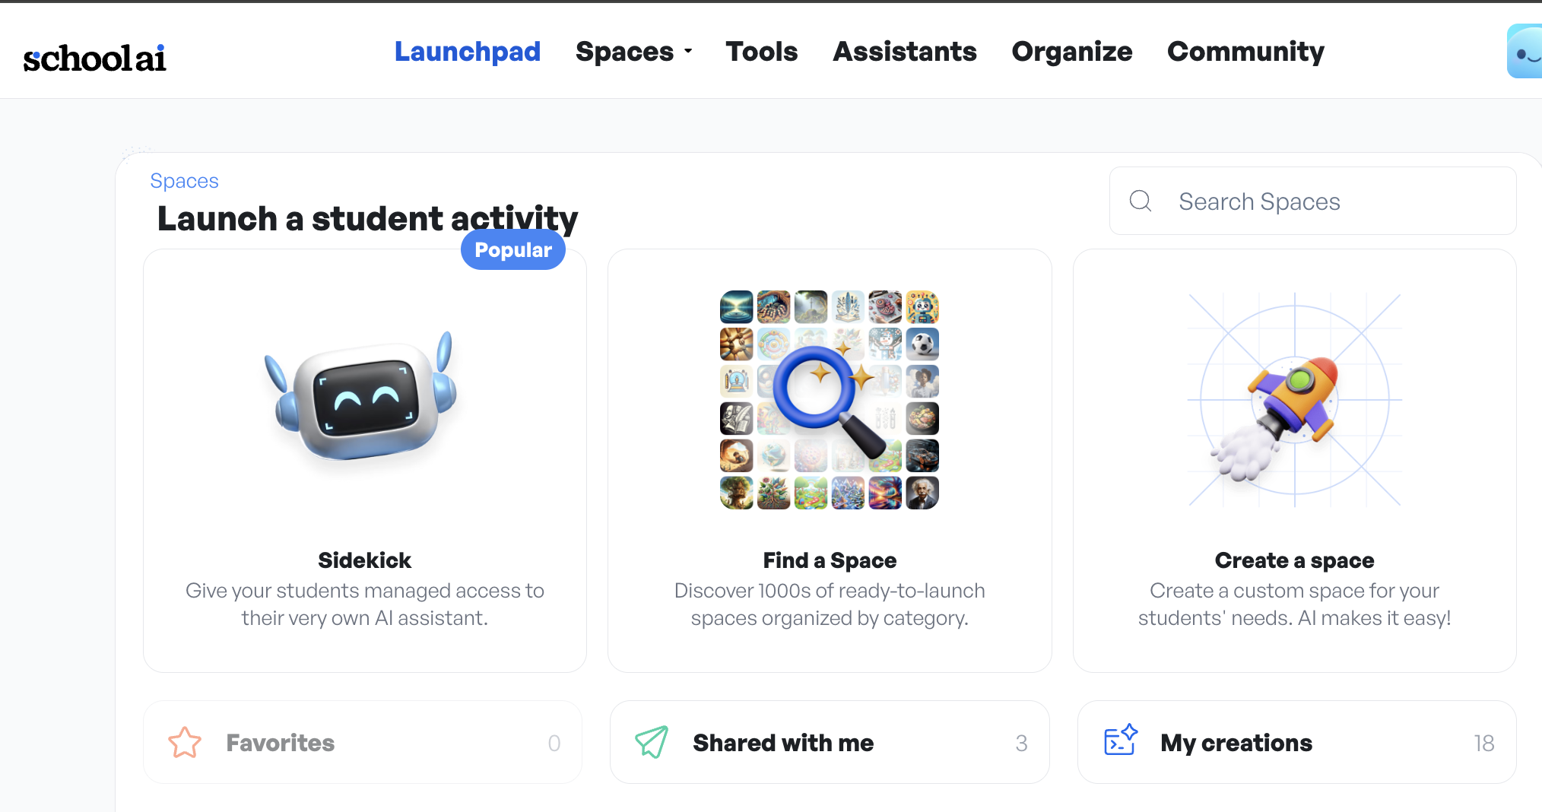
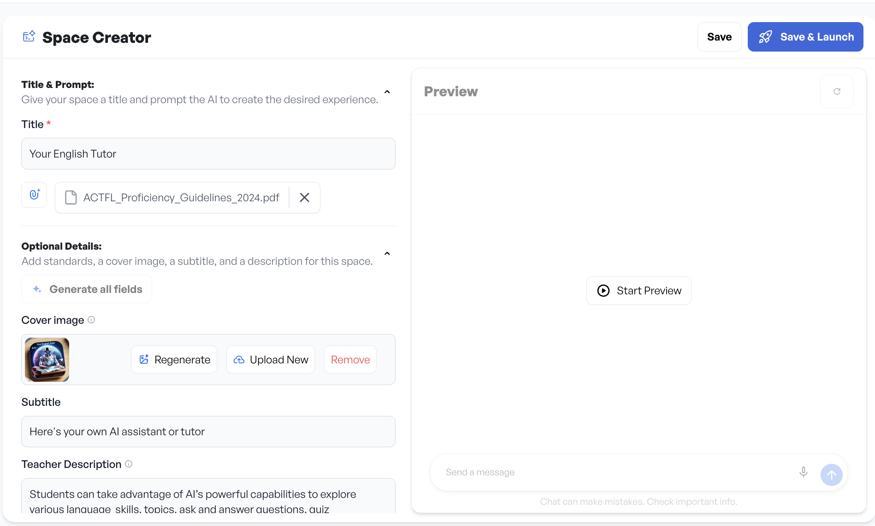
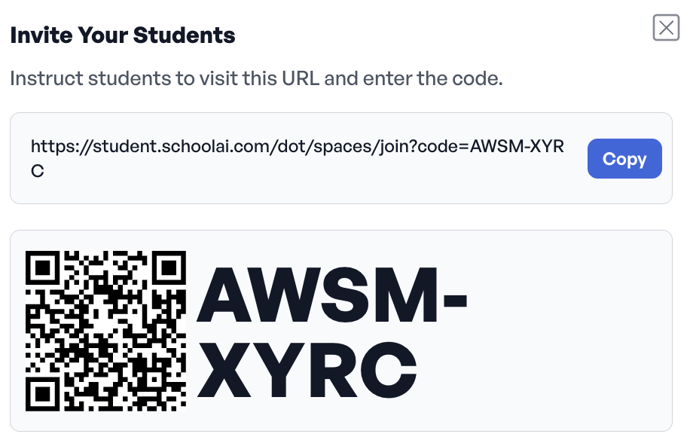
BYU
School AI
Akira & Camy
Material creation with guided prompts:
chatbots, in-class quizzes,newsletters
worksheets, lesson plans, PBL tutor
Using SchoolAI: A Basic Tutorial for Teachers (Youtube)

Slide 25
BYU
Q & A by Shantu
Share one takeaway from this presentation and teach that thing to the frenemy next to you.
What makes a test item truly ‘human’?
How would you explain your AI-testing strategy to a colleague who doesn’t trust the technology?
How do you see AI changing the future of language testing in the next 5 years?
Where do you draw the line between AI assisting and AI replacing teachers in test creation?
If I had one golden rule for using AI in test design, it would be __________.
If you had to describe your biggest fear about AI in assessment in one sentence, what would it be?
Drop your best idea, hack, or question on the Padlet before you leave.

Slide 26
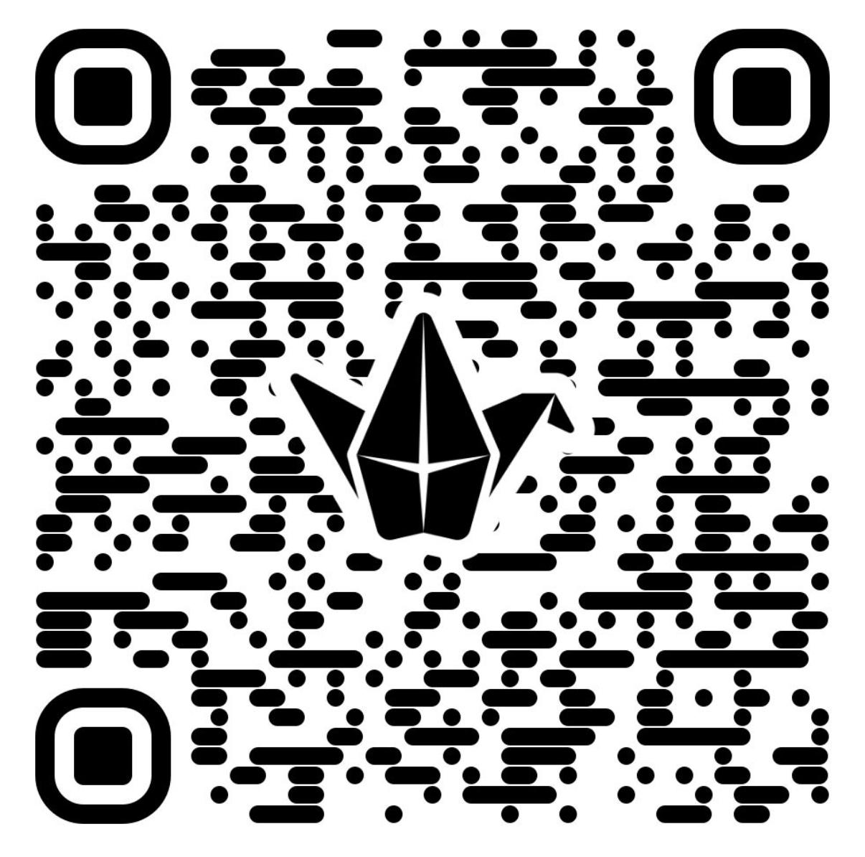
BYU
Learning from
Each Other

Slide 27
BYU
Please feel free to contact us
Joyce Tan- cct22@student.byu.edu
Shantona Mir- mshantu@student.byu.edu
Akira Nagahama- nagahama@student.byu.edu
Ginny Tien Le- tienle95@student.byu.edu
WenXuan Wan- wenxuanw@student.byu.edu
Vidya Irene Purushottam - vidyaip@byu.edu

