Slide 1
English for Legal Purposes
12/10/2025
ELP
LING 677
LL.M preparation courses at the ELC

Slide 2
TABLE OF CONTENTS
01
02
03
04
05
Intro and Background
Listening - Outcomes
Reading - Materials
Speaking - Assessment
Writing - Learning Experiences

Slide 3
Introduction and Overview
Mercury is the closest planet to the Sun and the smallest one in the entire Solar System. This planet’s name has nothing to do with the liquid metal, since Mercury was named after the Roman messenger god. Despite being closer to the Sun than Venus, its temperatures aren't as terribly hot as that planet’s. Its surface is quite similar to that of Earth’s Moon, which means there are a lot of craters and plains

Slide 4
01
Introduction and Background
12/10/2025
ELP
LING 677

Slide 5
Course Audience & Purpose
Partnership between the ELC & BYU’s Law School
Helping international students with TOEFL Scores in their 80’s
Not preparing for a Juris Doctorate. Plan to return home and practice law in their home country.

Slide 6
Course Structure
January 2026
  Initial, small-scale pilot
  One student, from the Ivory Coast
  Will attend regular ELC classes & work with a tutor on legal content.

Slide 7
Course Structure
January 2027
  Aim for 8 prospective LLM students
  Students in their own legal track
  4 Courses: Reading, Writing, Speaking, Listening
  Integrated vocabulary and grammar

Slide 8
02
Listening - Outcomes
12/10/2025
ELP
LING 677

Slide 9
Course Learning Outcomes: Overview
•Understands authentic academic and legal spoken English
•Identifies explicit & implicit main ideas and supporting details
•Recognizes legal reasoning, rhetorical strategy, tone, stance
•Follows fast-paced delivery, interruptions, topic shifts
•Tracks argument flow through suprasegmental cues

Slide 10
Strategies, Integration & Vocabulary
•Applies selective, intensive, extensive & interactive listening strategies
•Uses predictive listening & effective note‑taking (mapping, flow notes, paraphrasing)
•Monitors comprehension and uses repair strategies
•Connects listening content to prior legal knowledge; synthesizes across texts
•Understands and infers academic & legal vocabulary and formulaic expressions

Slide 11
03
Reading - Materials
12/10/2025
ELP
LING 677

Slide 12
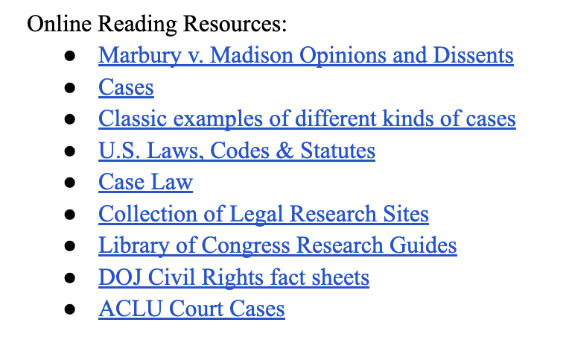
General Online Sources

Slide 13
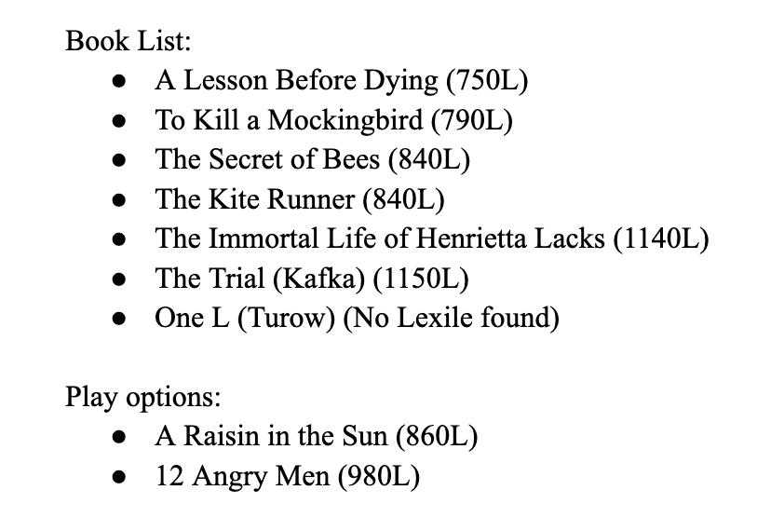
University of Pittsburgh Program

Slide 14
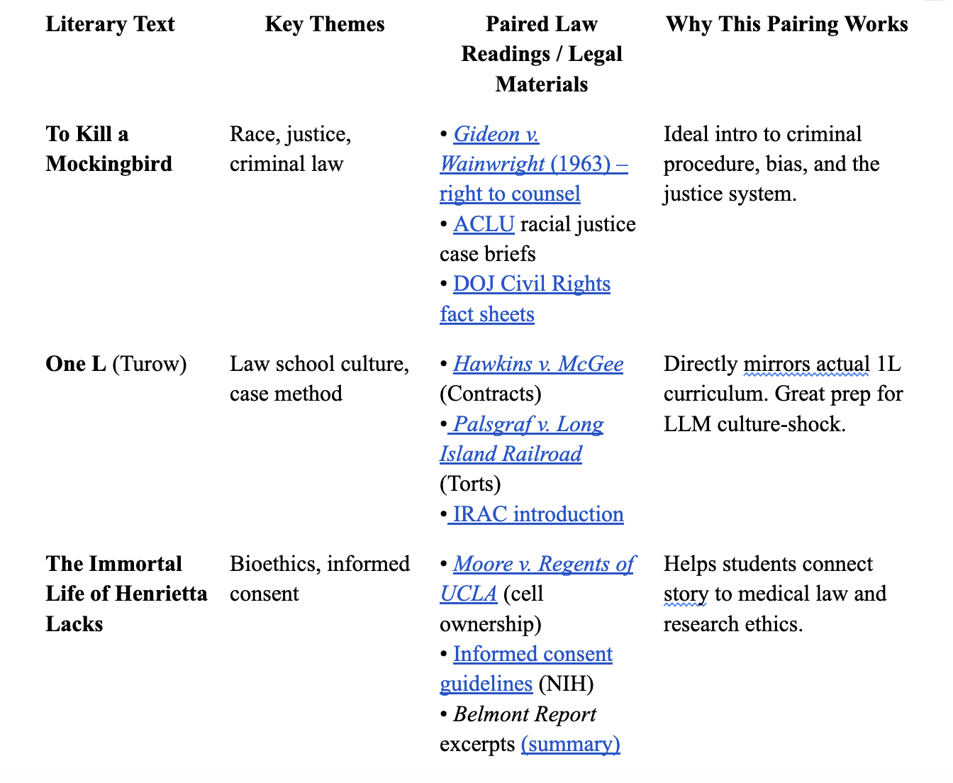
University of Pittsburgh Program

Slide 15
04
Speaking- Assessment
12/10/2025
ELP
LING 677

Slide 16
Summative Assessment
Oral Case Analysis Presentation
Mini Moot Court / Orgal Argument
Listening-Based Oral Exam (Case Summary + Hypothetical)
Final “Professional Communication” Task (Client Meeting Simulation)

Slide 17
Formative Assessment
Oral Case Brief “Think-Pair-Share”
“Explain it to a Client” Role-Play
Legal Hypotheticals Carousel
Micro-Presentations on Legal Terms
Listening-to-Speaking “Case Summary + Q+A”
“Clarify the Professor”

Slide 18
05
Writing -
Learning Experiences
12/10/2025
ELP
LING 677

Slide 19
Writing Learning Experiences
Drafted Assignments
Parallel Genres
Actual Legal Genres
Policy Brief
Literature Review
Memo
Discussion Post
Professional Emails
Legal Brief
Legal Research
Legal Memo
N/A
Professional Communication

Slide 20
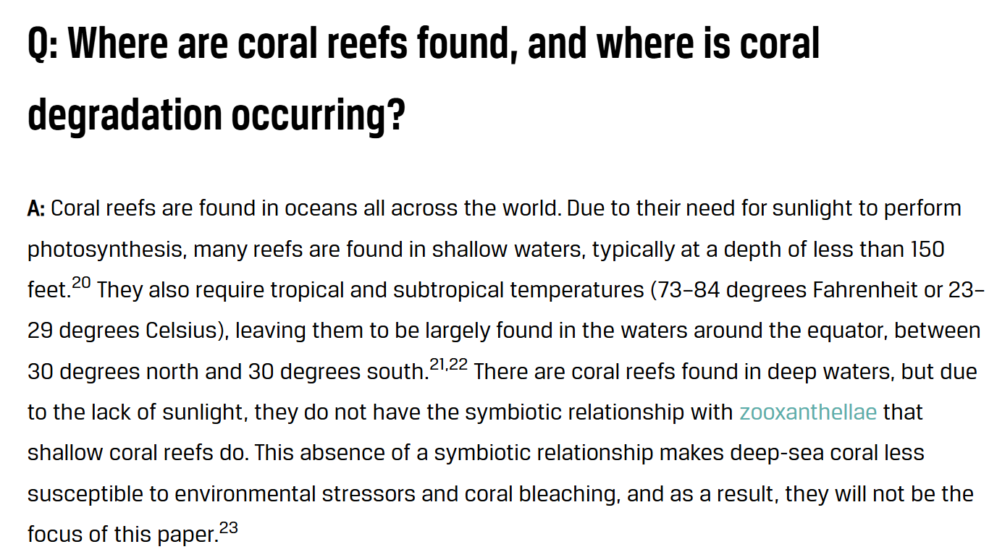

Slide 21
Writing Learning Experiences
Timed Assignments
Argumentative TW
  Strategies
  Counter arguments
  Fluency
  Cohesion

Slide 22
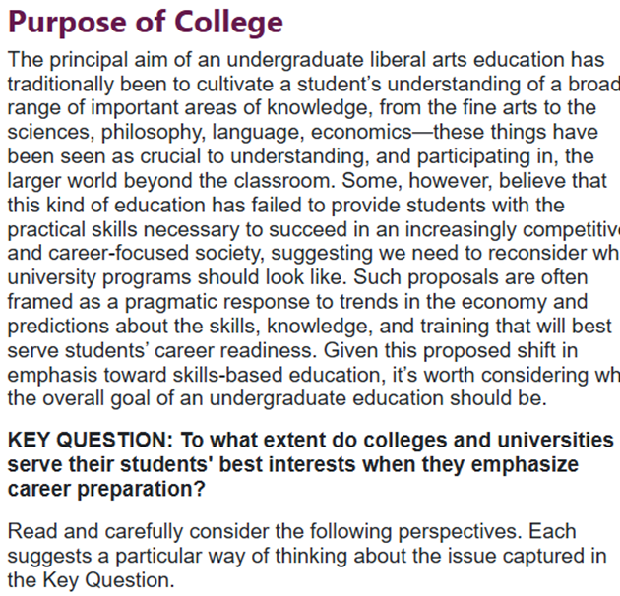
<- Background/Context
<- ACTFL Superior level problem
<-Key Question and opinion prompt

Slide 23
THANK YOU

